Slide 1
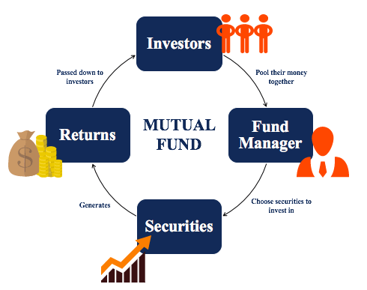
Lecture 4: Mutual funds (unit trusts)
HE Tai-Sen
FINANCIAL ECONOMICS
Notes:
Lecture time: 1.5 hr

Slide 2
Mutual funds (unit trusts)
Outline
Mutual Funds (4.1, 4.2, 4.3, 4,4)
Investment companies
Mutual funds, Costs of investing in mutual funds
Exchange-traded funds

Slide 3
Mutual funds (unit trusts)
Investment Companies
Investment Companies: financial intermediaries that collect funds from individual investors and invest those funds in a potentially wide ranges of securities or other assets. (refer to SEC’s website)
Notes:
Mutual funds are open-end funds. ETFs are generally structured as open-end funds, but can also be structured as UITs.
Source: https://www.sec.gov/investor/pubs/sec-guide-to-mutual-funds.pdf

Slide 4
Mutual funds (unit trusts)
Investment Companies
Three types of investments companies:
Unit investment trusts (UITs)
Open-end investment companies (Open-end funds/Mutual funds)
Closed-end investment companies (Closed-end funds)
Other investment organizations similar to investment companies
Real estate investment funds (REITs)
Hedge funds
Notes:
Mutual funds are open-end funds. ETFs are generally structured as open-end funds, but can also be structured as UITs.
Source: https://www.sec.gov/investor/pubs/sec-guide-to-mutual-funds.pdf

Slide 5
Mutual funds (unit trusts)
Investment Companies
Differences among the three types of investment companies:
Investment companies issue shares to their investors.
Mutual fund and UIT shares are redeemable (meaning that when investors want to sell their shares, they sell them back to the fund or trust). You can purchase/redeem based on the net asset value (NAV) per share which is computed at the end of each trading day.
NAV= (Market value of assets - liabilities)/(no. of shares outstanding)
Closed-end fund shares generally are not redeemable (when closed-end fund investors want to sell their shares, they generally sell them to other investors on the secondary market, at a price determined by the market).
Unlike mutual funds, UITs invest in a smaller diversified portfolio of securities and do not actively trade its portfolio. In other words, the UIT might invest in 10 securities and use a “buy and hold” strategy for those ten securities for the life of the UIT.

Slide 6
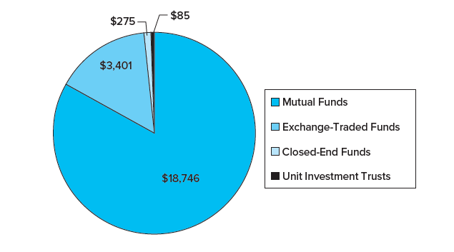
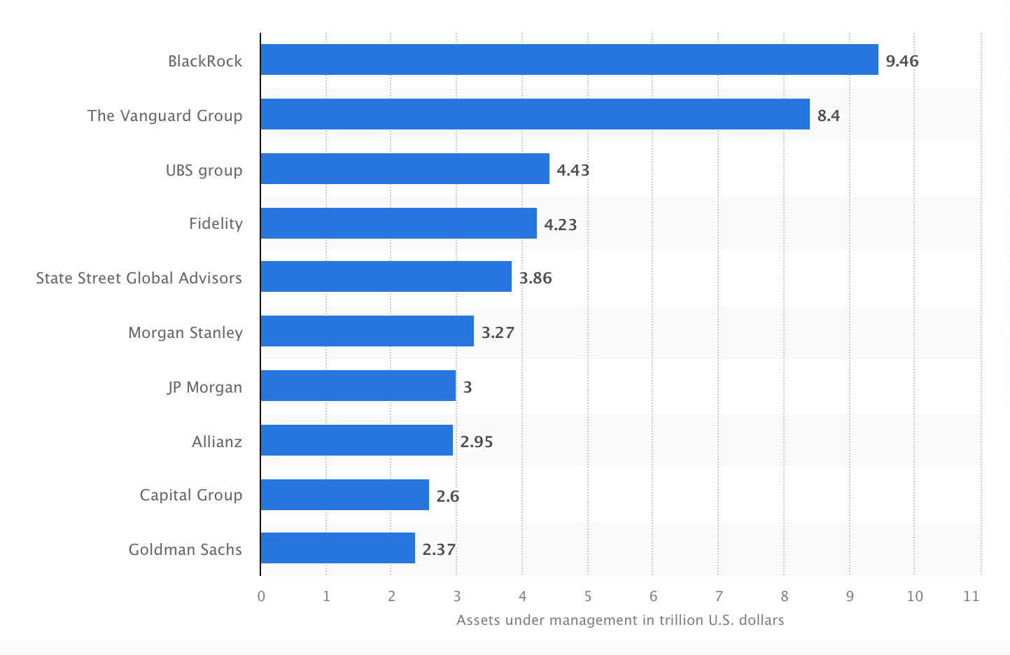
Mutual funds (unit trusts)
Mutual Funds
Mutual funds (known as unit trusts in Singapore) account for more than 90% of investment companies’ assets.
Leading investment management firms worldwide by assets under management (link)
Investment Company Assets Under Management, 2018 ($ billion)

Slide 7
Mutual funds (unit trusts)
Mutual Funds
Each mutual fund has a specified investment policy, which is described in the fund’s prospectus (summarized in product highlight sheet).
Based on their investment policies, mutual funds can be classified as:
Money market funds
Equity funds (income funds/growth funds)
Bond funds
Balanced/blended funds: they contain a bond component and an equity component in a specific ratio in a single portfolio. Many balanced funds are in fact funds of funds.
Index funds are mutual funds with a portfolio constructed to match or track a financial market index, such as S&P500 and STI. Its performance mirrors the performance of the index it tracks.

Slide 8
Mutual funds (unit trusts)
Mutual Funds
How funds are sold:
Direct-marketed: sold through mails, office of the fund, over the phone, over the internet. Investors contact the fund directly to purchase shares.
About half of fund sales are distributed through a sales force. Brokers and financial advisers receive a commission for selling shares to investors.
Investors buy shares in investment companies, and ownership is proportional to the number of shares purchased. The value of each share is called the net asset value (NAV).
NAV= (Market value of assets - liabilities)/(no. of shares outstanding)
Late trading: The price of a mutual fund does not vary during the course of the trading day because it is set at the end of each trading day. You buy or sell a mutual fund at the end of the day after the price for that day has been set, based on the value of the individual investments in the fund.

Slide 9
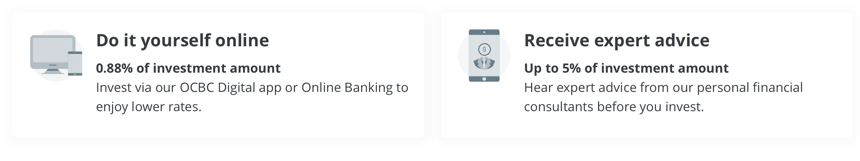

Mutual funds (unit trusts)
Mutual Funds
Fee structure
Front-end load (i.e., sales charge): commission or sales charge paid when you purchase the shares. (mostly less than 6%)
OCBC sales charge: ______
Back-end load (i.e., redemption fee): redemption fee incurred when you sell your share. (5%-6% for those who charge this fee)
Operating expenses: the costs incurred by the mutual fund in operating the portfolio, including administrative expenses and advisory fees paid to the investment manager. These expenses range from 0.2% -1.5%.
12b-1 Charges: distribution costs such as advertising, promotional literature, including annual reports and prospectuses, and commissions paid to brokers who sell the fund to investors. (limited to 1% of a fund’s average net assets per year)
(Total) Expense ratio

Slide 10
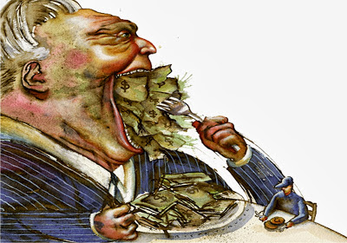
Mutual funds (unit trusts)
Mutual Funds
It can't be said enough: with funds, costs matter. Even though lower fees=higher returns, investors typically fail to choose low-cost funds (Choi et al., 2010, The Review of Financial Studies).
Notes:
Investors pay more attention to relatively irrelevant information like past performance. (Choi et al., 2010, The Review of Financial Studies).
Should we buy mutual funds? Fund managers vs. monkey investors
http://www.youtube.com/watch?v=a41LhZE5Iec
http://www.forbes.com/sites/rickferri/2012/12/20/any-monkey-can-beat-the-market/
Why Does The Law of One Price Fail? An Experiment on Index Mutual Funds (James Choi, David Laibson, and Brigitte Madrian)
Hillary Cliton (link)
Obama (link) (link)

Slide 11
Mutual funds (unit trusts)
Exchange-Traded Funds (ETFs)
ETFs = Exchange-Traded Funds
ETFs are offshoots of mutual funds that allow investors to trade index portfolios just as they do shares of stocks. So, unlike typical mutual funds, ETFs can be traded on national stock exchange during trading time.
Notes:
Investors pay more attention to relatively irrelevant information like past performance. (Choi et al., 2010, The Review of Financial Studies).
ETFs are typically classified as open-end funds because the fund size can be adjusted according to the market supply and demand. However, the redemption process of ETFs works differently from traditional mutual funds. You can refer to the following link for the process:
https://www.schwabassetmanagement.com/content/understanding-etf-creation-and-redemption-mechanism
Should we buy mutual funds? Fund managers vs. monkey investors
http://www.youtube.com/watch?v=a41LhZE5Iec
http://www.forbes.com/sites/rickferri/2012/12/20/any-monkey-can-beat-the-market/
Why Does The Law of One Price Fail? An Experiment on Index Mutual Funds (James Choi, David Laibson, and Brigitte Madrian)
Hillary Cliton (link)
Obama (link) (link)

Slide 12
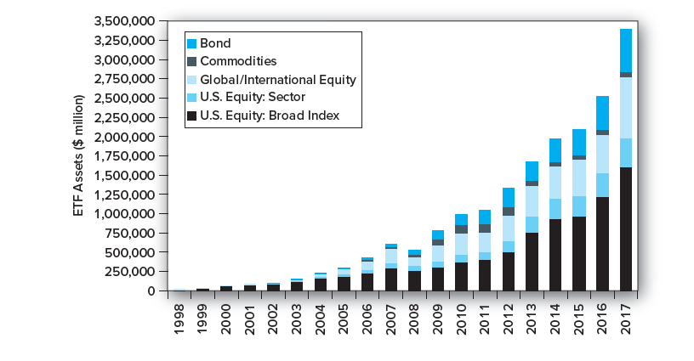
Mutual funds (unit trusts)
Exchange-Traded Funds (ETFs)
ETFs were first introduced in 1993 (spider, nickname for SPDR, which tracks the S&P 500 Index). Since its inception, it has gained significant popularity.
ETFs are usually passively managed and charge lower fees than actively managed mutual funds.
Note: Until 2008, ETFs were required to track specified indexes. Starting in 2008, the SEC granted approval for so-called actively managed ETFs (For example, ARKK).
Notes:
Investors pay more attention to relatively irrelevant information like past performance. (Choi et al., 2010, The Review of Financial Studies).
ETFs are typically classified as open-end funds because the fund size can be adjusted according to the market supply and demand. However, the redemption process of ETFs works differently from traditional mutual funds. You can refer to the following link for the process:
https://www.schwabassetmanagement.com/content/understanding-etf-creation-and-redemption-mechanism
Should we buy mutual funds? Fund managers vs. monkey investors
http://www.youtube.com/watch?v=a41LhZE5Iec
http://www.forbes.com/sites/rickferri/2012/12/20/any-monkey-can-beat-the-market/
Why Does The Law of One Price Fail? An Experiment on Index Mutual Funds (James Choi, David Laibson, and Brigitte Madrian)
Hillary Cliton (link)
Obama (link) (link)

Slide 13
Mutual funds (unit trusts)
Exchange-Traded Funds (ETFs)
Examples of low-fee ETFs:
Two ETFs tracking STI:
SPDR STI ETF (ES3; expense ratio=___%)
Nikko AM STI ETF (G3B; expense ratio=___%)
An ETF tracking S&P 500:
Vanguard S&P 500 ETF (VOO; expense ratio=___%)
An ETF tracking world major stocks:
Vanguard Total World Stock ETF (VT; expense ratio=___%)
Notes:
0.3%; 0.3%; 0.03%; 0.07%

